Slide 1
BOOK A DOCTOR USING MERN STACK
TEAM MEMBERS:
1. MUHAMMAD SUHAIL M (211521205089)
2. MANOJ (211521205081)j
3. MMOHAMMED SHAHBAN M (211521205085)

Slide 2
ABSTRACT
This project addresses the growing need for an efficient healthcare booking system."Book a Doctor Using MERN Stack" is a web application that allows users to easily find doctors, view their profiles, check availability, and book appointments online.The system benefits both patients, who can quickly access healthcare professionals, and doctors, who can manage their appointments more effectively.Built with a responsive front-end using React and Tailwind CSS and a powerful backend using Node.js, Express, and MongoDB, the project provides seamless interaction and real-time data updates.

Slide 3
INTRODUCTION
To provide a platform where patients can easily book doctor appointments and doctors can manage their availability.
Technologies Used:
MongoDB: Database for storing user, doctor, and appointment details.
Express.js: Backend framework handling API requests and server-side logic.
React.js: Frontend library to create a responsive, user-friendly interface.
Node.js: Server environment for building scalable, real-time applications.
Tailwind CSS: Utility-first CSS framework for designing modern, responsive UI.
Target Audience: General public, doctors, and healthcare facilities.

Slide 4
PROPOSED SYSTEM
The proposed system allows for real-time appointment booking and management, utilizing the MERN stack for a robust, scalable, and user-friendly platform. Key features include:
User-friendly interface for booking doctor appointments.
Real-time availability of doctors.
Admin approval for doctor registrations.
Appointment management system for doctors and users.
Notifications and follow-up summaries for users after appointments.

Slide 5
FUTURE IMPLEMENTATION
In the future, we plan to enhance the system with additional features such as:
Telemedicine Integration: Enabling online video consultations directly through the platform.
AI-based Doctor Recommendation: Suggesting doctors based on patient history and ratings.
Payment Gateway: Integrating online payment systems for appointment fees.
Multilingual Support: Expanding accessibility by offering the platform in various languages.

Slide 6
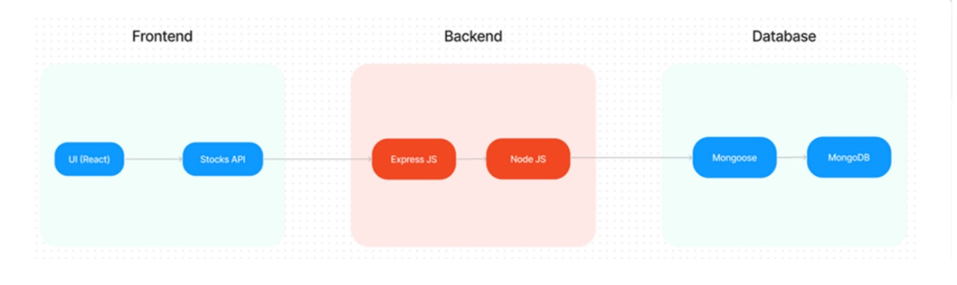
ARCHITECTURE DIAGRAM

Slide 7
FRONT END DEVELOPMENT
React.js: Handles the interactive user interface, components, and dynamic routing for a smooth user experience.
Tailwind CSS: Provides utility-first CSS to design a responsive and modern UI with minimal effort.
Axios: Facilitates asynchronous API requests to interact with the backend.
User Interface: Intuitive, with separate dashboards for users, doctors, and admins, using filters for selecting doctors and managing appointments.
Key Pages:
Sign-up/Login: User authentication and registration.
Doctor Listing: Search and filter doctors based on preferences.
Appointment Booking: Select a time slot, upload documents, and confirm appointments.

Slide 8
INTEGRATION
Integration between the frontend and backend is achieved through RESTful APIs, ensuring smooth communication for booking appointments, updating profiles, and managing appointments. Axios handles data fetching in the frontend, while Express.js serves the necessary endpoints and MongoDB stores persistent data.
Key API Endpoints:
/users: Registration and authentication.
/appointments: Fetch, book, and manage appointments.
/doctors: Fetch doctors' profiles and availability.

Slide 9
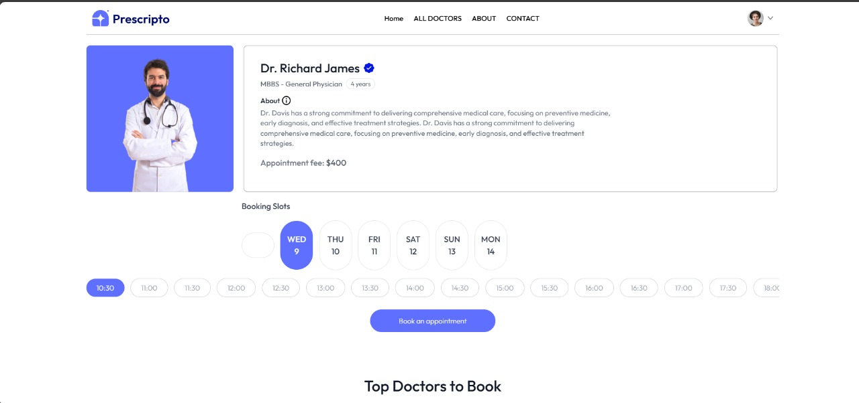
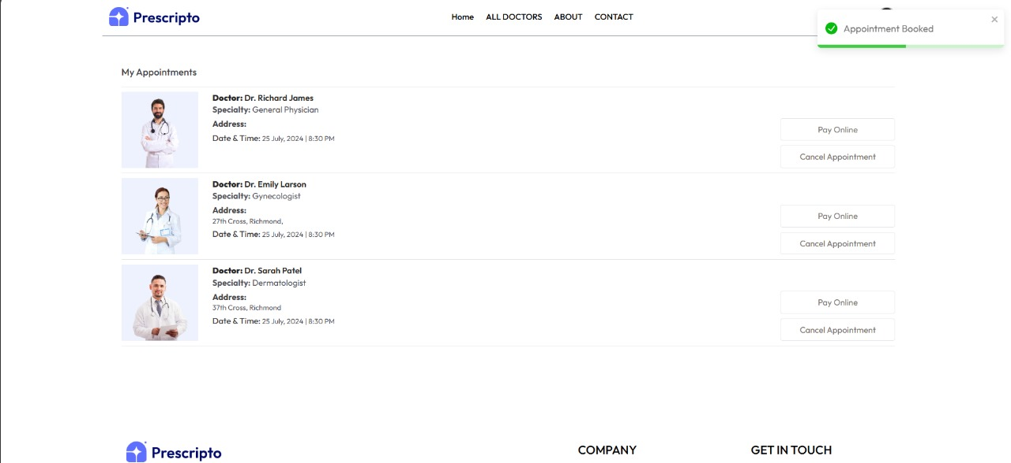
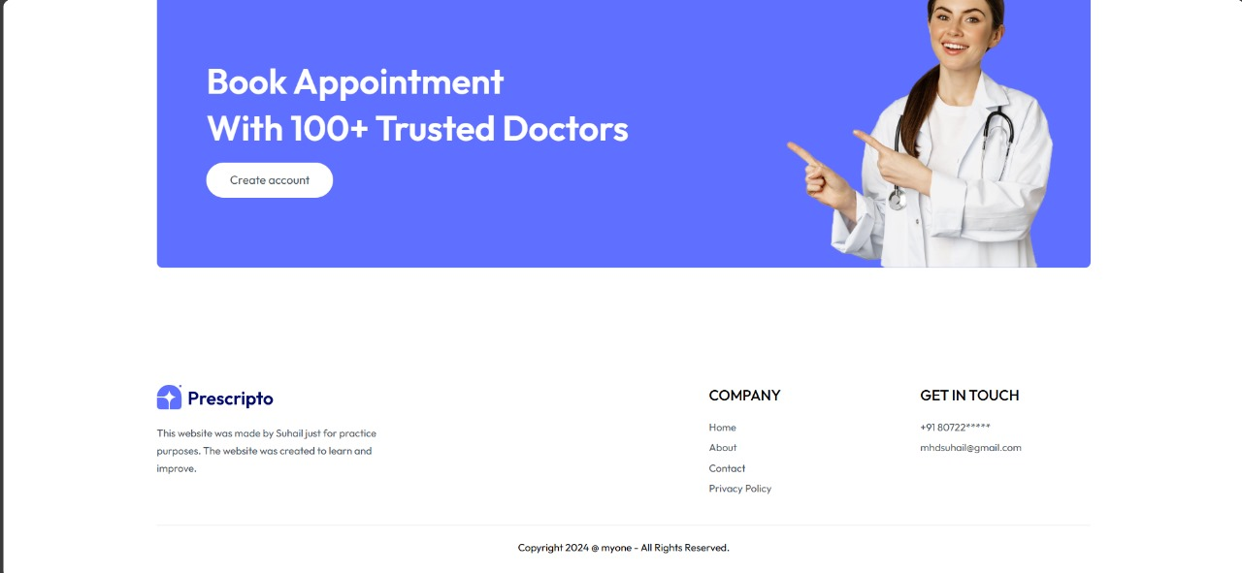
MODELS

Slide 10
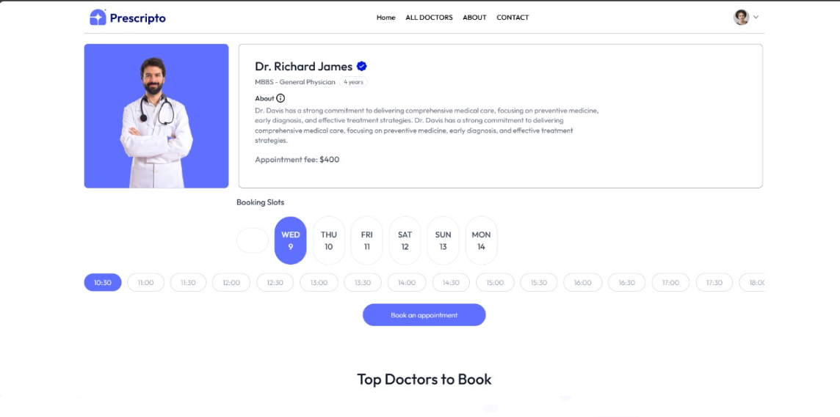
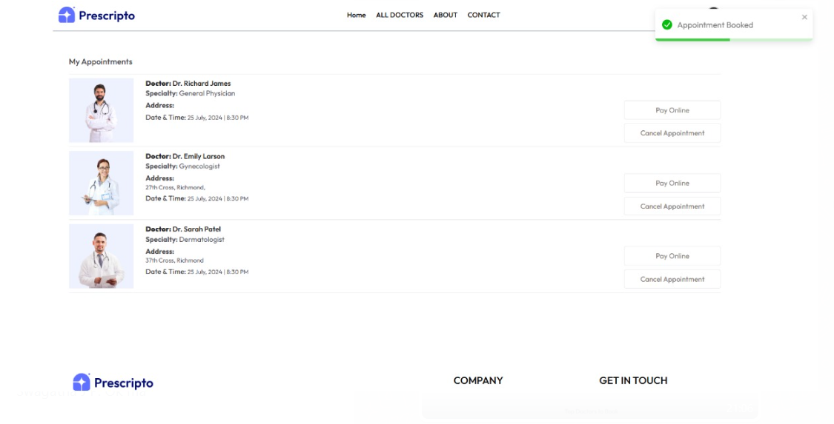
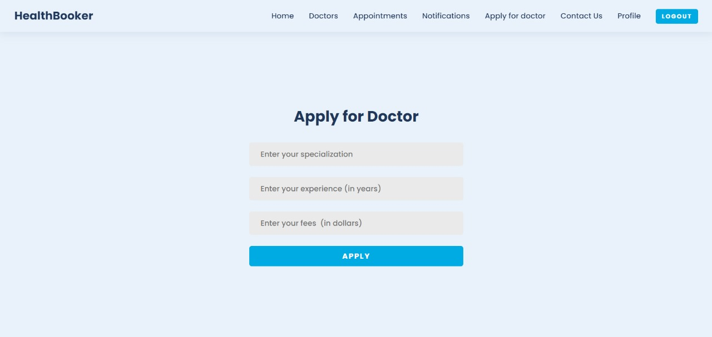
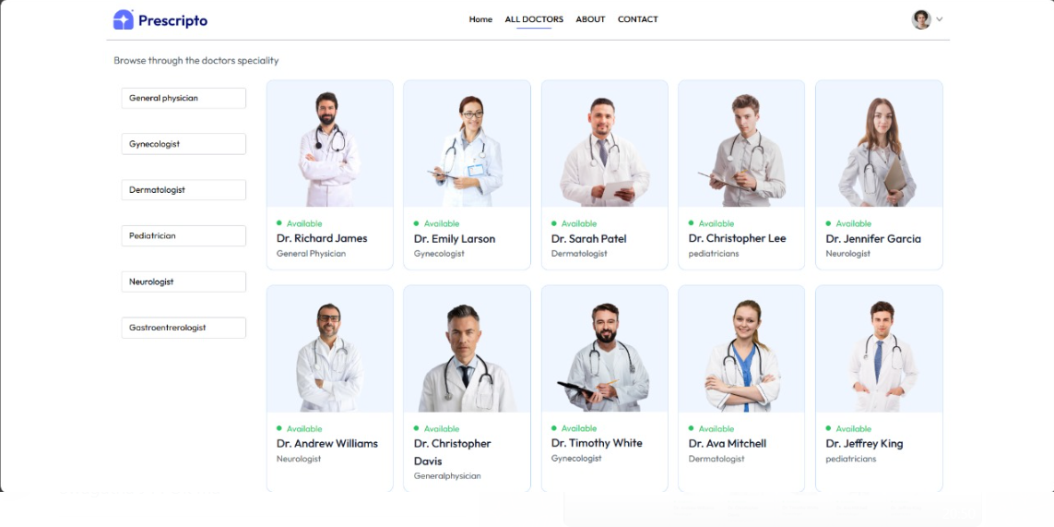

Slide 11
BACKEND DEVELOPMENT
Express.js: Backend framework handling APIs, business logic, and routing. It ensures efficient handling of user requests, including appointment bookings and user management.
MongoDB: The database stores user profiles, appointment data, and doctor details securely. It allows efficient retrieval and updates to maintain real-time synchronization.
Multer: Middleware for handling file uploads like medical reports or insurance documents.
Backend API:
POST /register: User and doctor registration.
GET /doctors: Fetch doctor listings.
POST /bookAppointment: Book a doctor's appointment.
GET /appointments: Manage appointments for users and doctors.

Slide 12
CONCLUSION
Achievements: Successfully developed a functional doctor booking platform that simplifies the appointment scheduling process for both doctors and patients.
Key Features:Secure authenticationReal-time booking systemResponsive design with Tailwind CSSRobust back-end API.
Future Scope: The system can be expanded to include virtual consultations, online payments, and more advanced features like doctor reviews and multi-language support.
Learning Outcomes: Gained in-depth experience with the MERN stack, learned best practices for building scalable applications, and improved skills in API integration and full-stack development.

Slide 13
THANK YOU

